Slide 1





Modern BA - way to delivering value
Karolina Zmitrowicz

Slide 2
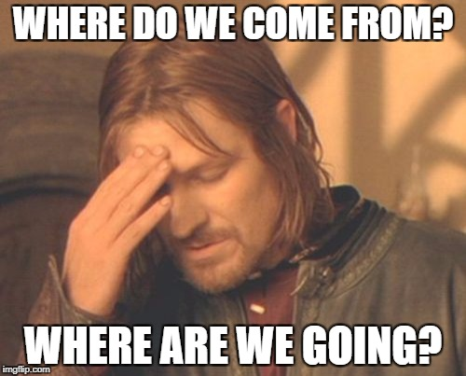

Slide 3


Quo vadis, BA?
AS IS
Challenges
TO BE
Transformation

Slide 4

Traditional approach
BA is:
  Someone designing software systems
  Someone „who deals with requirements”
  Some „who knows business”
  „Project secretary”

Slide 5
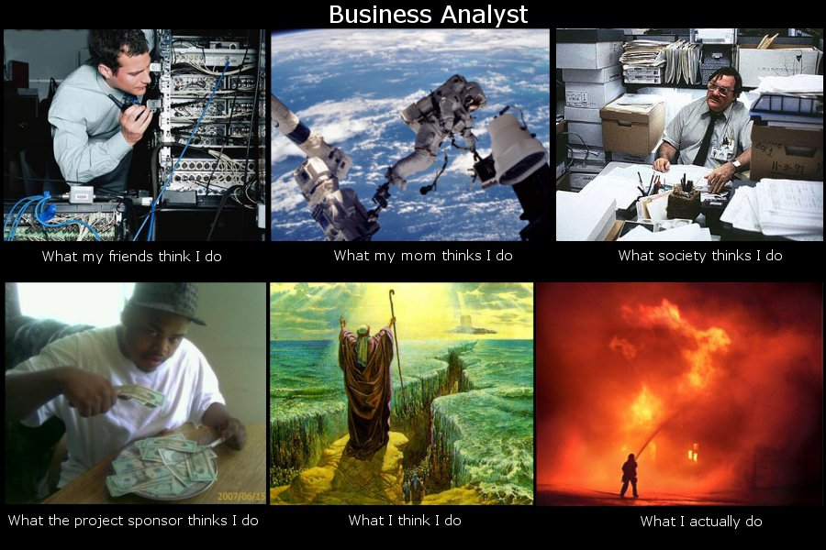
Kim jest analityk?
Czym się zajmuje?

Slide 6
Traditional approach
Responsibilities of a business analyst:
  Linking business and IT
  Communication with stakeholders
  Business needs elicitation
  Project scope management
  Solution design
  Development/test support
  ..... 2 years later....
  Documentation, documentation and more documentation

Slide 7
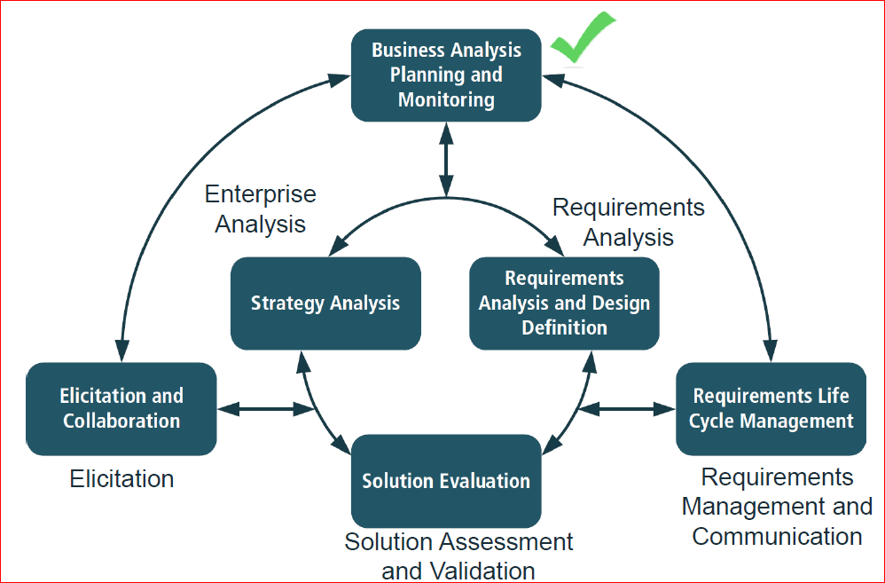
Traditional approach
BABOK® Guide
Delivering value to stakeholders
Introducing change to an organization

Slide 8
Does it all meet current needs?

Slide 9


Slide 10
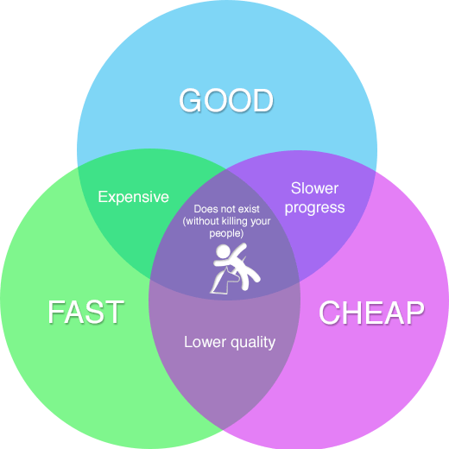
Challenges
No clear boundaries between business, technology, sociology
Multidisciplinary approach
Market expectations: as soon ASAP

Slide 11
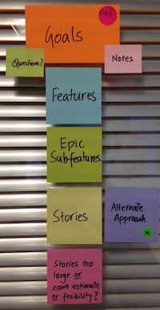
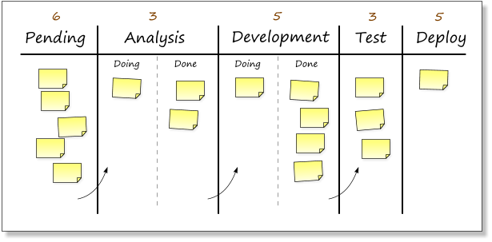

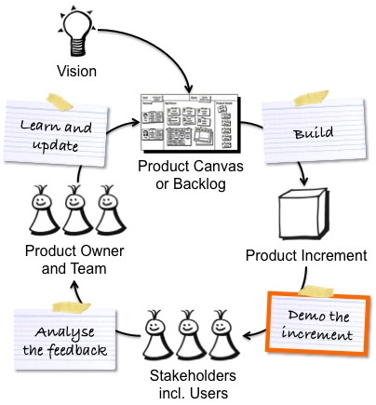
Challenges
To be agile...
Lean Software Development
Eliminate waste
Amplify learning
Decide as late as possible
Deliver as fast as possible
Empower the team
Build integrity in
See the whole
Minimum Viable Product (MVP)
Minimal Marketable Products (MMP)

Slide 12
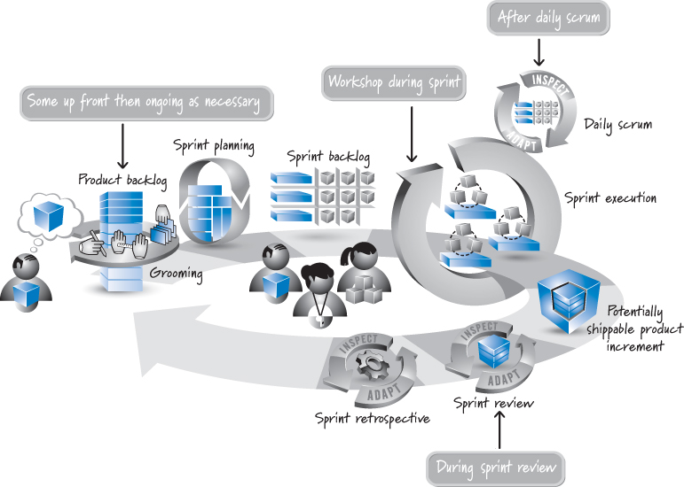
Wyzwania
To be Agile...
Where is the place for business analysis?
Kenneth S. Rubin, Published Jul 26, 2012 by Addison-Wesley Professional.
Essential Scrum: A Practical Guide to the Most Popular Agile Process

Slide 13

How to live?!

Slide 14
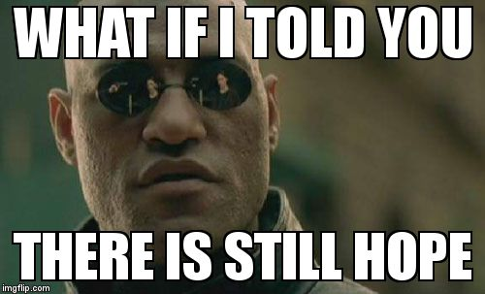

Slide 15
Wyzwania
To be Agile...
BA effort
BA effort
Value!
Kenneth S. Rubin, Published Jul 26, 2012 by Addison-Wesley Professional.
Essential Scrum: A Practical Guide to the Most Popular Agile Process

Slide 16




Main challenge: business analyst competencies
BA works
Product Owner
Team
BA between PO and team
BA works

Slide 17
Main challenge: business analyst competencies
BA works
Product Owner
Team
BA works
BA inside the team

Slide 18
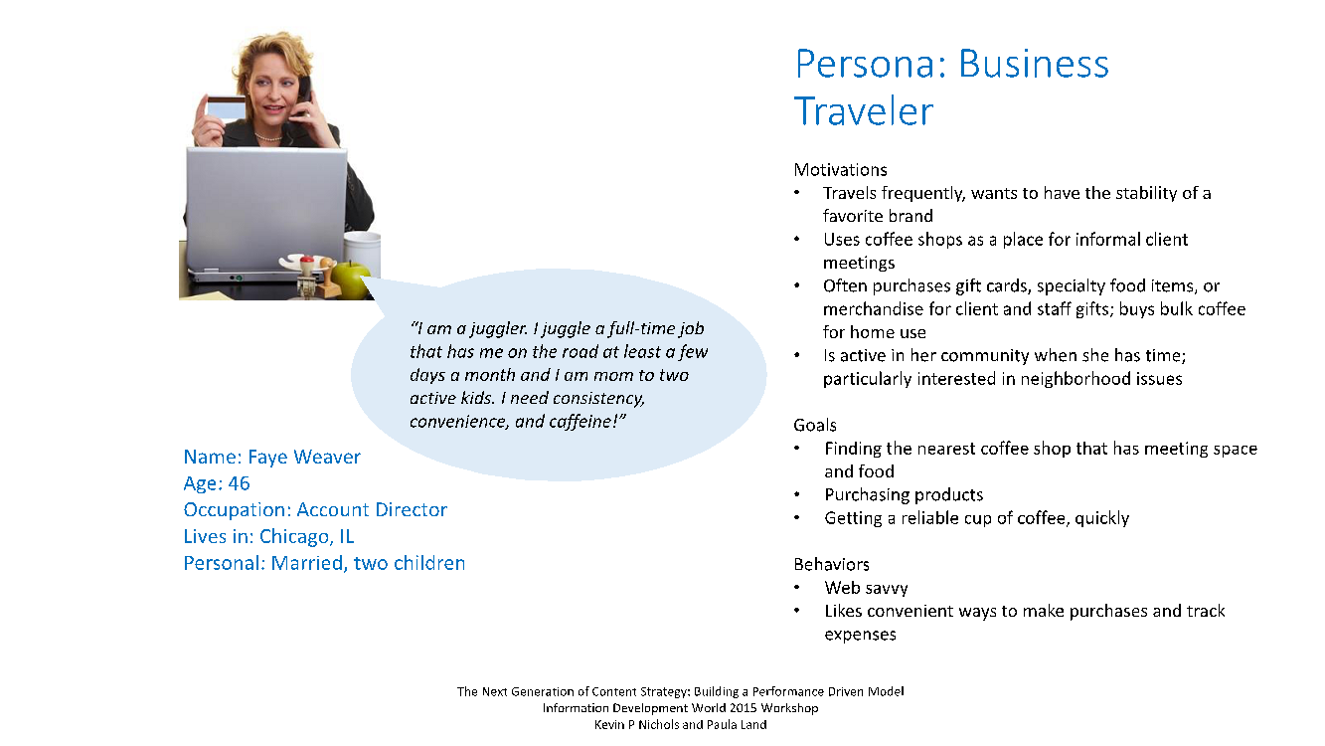
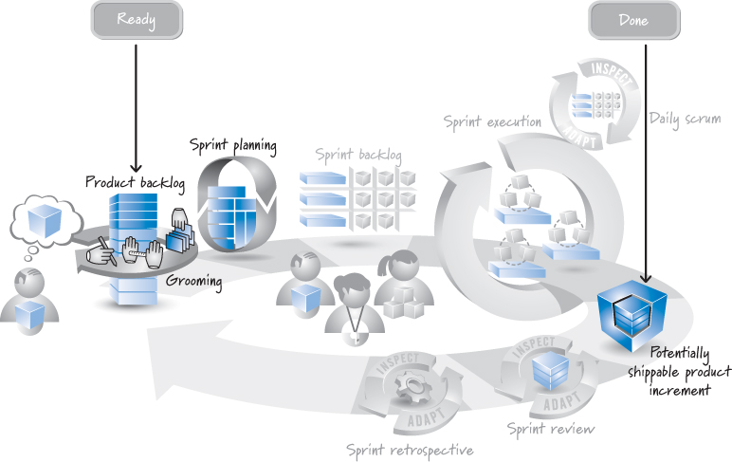

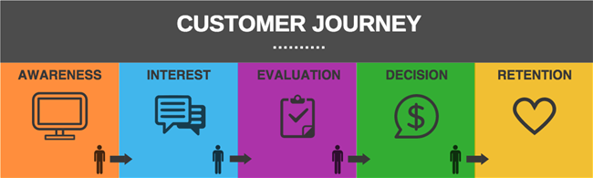
To be multidiscipliary...
Market research
User research
Marketing
Service design
QMS
Additional skills and competencies
http://www.blastam.com/customer-journey.aspx

Slide 19
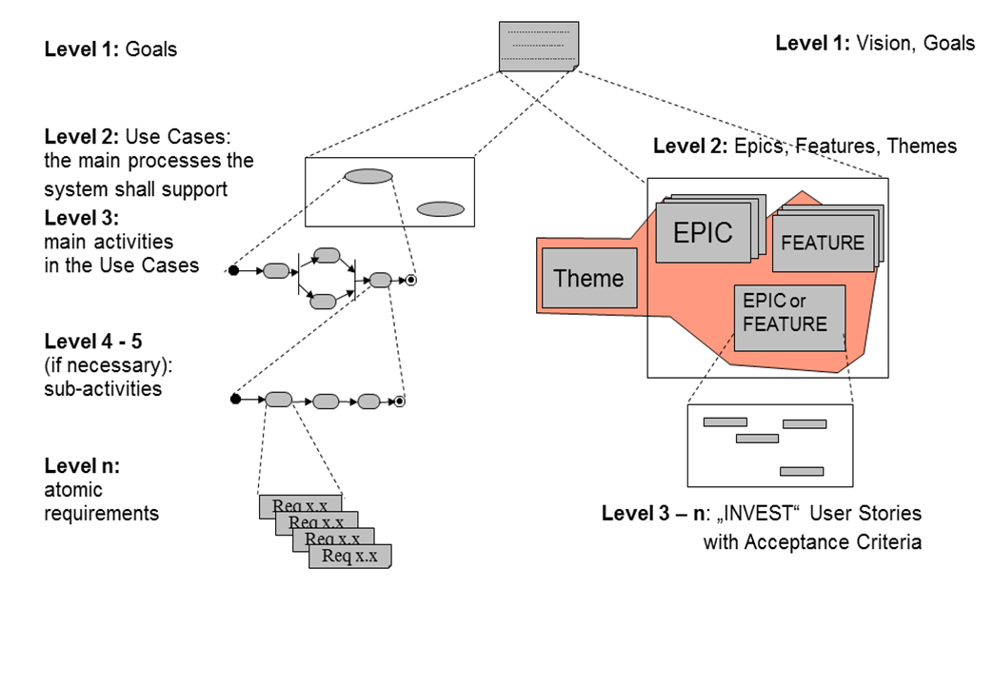
To change the way of thinking...
AS IS
TO BE
Change
IREB RE@Agile Syllabus

Slide 20
TO BE
Business level
Product level
Project level
Program level
Organization level
Iteration level

Slide 21

TO BE
Change agent/Visionary
Process owner
Product owner
Copyright@Karolina Zmitrowicz

Slide 22
Modern BA
Agile, multidisciplinary, seeing the whole change desiger
Business Analysis
UX
System Design
Strategy Analysis
Market Research
Innovation
Digital Transformation
Psychology

Slide 23


Slide 24
Thank you for your attention!
Stowarzyszenie Jakości Systemów Informatycznych
ul. Poznańska 16 lok. 4
00-680 Warszawa
Karolina Zmitrowicz k.zmitrowicz@sjsi.org

Slide 25

reQuest for innovation
www.request.pl
15.11.2017
Early Bird Tickets – 01-15.10.2017

